Slide 1
COVID19 LIVE TRACKER AND ALERT SYSTEM

Slide 2
Team Member Details
Name | Registration Number
Harshit Mishra | 19BCE0799
Pankaj Shivnani | 19BCE0821
Alokam Nikhitha | 19BCE2555
Galla Kiran | 19BCE2583

Slide 3
Aim of the Project
In this stage of pandemic, it is very important for us to maintain proper etiquettes and precautionary steps to contain the COVID19 pandemic.
The pandemic is yet far from over but the time spent by human in lock-down has taken a toll on their mental health. While we need to make sure that we stay indoors in COVID affected area, it is equally important for us to stay social and connected where the cases have eased out.
The problem lies in effective means of knowing the COVID affected areas. Our project aims at easing out this process of knowing if the locality has an outburst of COVID19. While we display the real time data to our users, we also alert them to strengthen their precautionary measures when the number of cases exceeds a given total.

Slide 4
Literature Survey
S.No | Paper Title | Name of the Conference/Journal, Year | Technology Used
1. | Prediction and Effective Monitoring of Flood Using Arduino System Controller and ESP8266 Wi-Fi Module | International Journal of Communication and Networking System, 2019 | The authors of this paper use Arduino Uno Controllers to control all the operations of the system. Wireless sensors are used to measure Temperature, Wind, Humidity, etc. All the collected data is stored on cloud and is accessed using ThingSpeak website and ESP8266 wifi module. Embedded C language is used for developing the proposed system. The authors use a C library called “wiring” for basic input and output functions. Main advantage of this model is to reduce the hardware component dependency of this system.
2. | Covid-19 fever symptom detection based on IoT cloud | International Journal of Electrical and Computer Engineering, 2020 | The authors use a Human Body Temperature Sensor(MAX30205) to detect Covid Symptoms. This data is then uploaded on the cloud platform using ThingSpeak with the help of ESP8266 node MCU. When any data value crosses a threshold, an alert is sent to the monitoring manager with the help of an SMS. Any device like Mobile Screens or Television Screens can be used to display visualizations of the collected data.

Slide 5
Literature Survey
S.No | Paper Title | Name of the Conference/Journal, Year | Technology Used
3 | Design of Real-Time Weather Monitoring System Based on Mobile Application Using ESP8266 | Journal Of Engineering Sciences, 2019 | The authors use several sensors to measure weather conditions like Temperature sensor(LM35), Humidity Sensor, Gas Sensor, LCD, ESP8266 Wifi Module. Raspberry Pi is used as the software tool. Node MCU ESP8266 platform allows sending the data collected by weather sensors to the server. This continuous process gives a real-time analysis and monitoring of data.The advantage of this approach is that it uses hardware tools that are cheaper and easily available and can be expanded to use more parameters.
4 | IoT-cloud based healthcare model for COVID-19 detection: an enhanced k-Nearest Neighbour classifier based approach | Springer, 2021 | The authors of this paper propose a classification based algorithm called Enhanced K-Nearest Neighbors(e-KNN) that is very similar to the traditional K-Nearest Neighbors algorithm. The major difference is that e-KNN computes the value of K dynamically and it also uses ACO (Ant Colony Optimization) based feature selection mechanism. Several performance metrics like Accuracy, Precision, Recall and F1-Score proved that the e-KNN performs much better than the traditional K-Nearest Neighbors algorithm. This system can work as a backend to an IoT based frontend. Similar methods like ESP8266 can be used to connect to a ThingSpeak cloud server and store and fetch data.

Slide 6
Literature Survey
S.No | Paper Title | Name of the Conference/Journal, Year | Technology Used
5. | IOT based smart patient monitoring system with emphasis on covid and associated respiratory diseases diagnosis | International journal of progressive research in science and engineering, vol.2, no.6, june 2021. | The authors of this paper Proposes a design to monitor the patient’s health conditions such as body temperature, pulse rate, respiration rate and send the message to the guardian using IOT platform. He also conducted an extensive survey to analyze how the usage of edge computing progresses the performance of Systems . The performance of edge computing is studied by comparing delay of network, occupation of bandwidth, Power utilization, and many other characteristics.An ardino Uno, heart rate-spo2 monitor, temperature sensor, Esp8266 and an LCD module are used to make the hardware module.
6. | Thing speak Based Sensing and Monitoring System for IOT with Matlab Analysis | International Journal of New Technology and Research, Volume-2, Issue-6, June 2016 | The author proposes a project which can provide and prove the strength of IOT using the Thing speak API that is capable to contribute the services for the purpose of building vast number of IOT applications and help to implement them on the public platform. From the project he concludes that Microcontrollers will get minimized and vanish into the environment, and IOT Leads to become universal and in every prospect and the Thing speak IOT Web service is definitely a fascinating web based technology that encompasses the ability to form the expectations of the engineers.

Slide 7
Literature Survey
S.No | Paper Title | Name of the Conference/Journal, Year | Technology Used
7. | Live tracking system | International Journal of Engineering Research & Technology, Vol. 9 Issue 06, June-2020 | The authors designs a GPS tracking device that sends location to the end user at a consistently high frequency. It offers user’s real-time location updates, every few seconds which can be critical for the safety of the loved ones. Smart phone at the parent side and the tracking module at child side that supports GPS and SMS as a minimum are the basic requirements. The Android App to be used is a digital dashboard where a graphic interface can be build. The tracked location is decided by the latitude and longitude. Using this parameter the user can verify the location by putting received values on the Google of latitude and longitude. The advantage of the proposed system is here the user get one more option to track the device i.e. Android Application which also include the map option for user to observe
8. | Internet of things - Based photovoltaic parameter monitoring System using nodemcu ESP8266 | International Journal of Electrical and Computer Engineering (IJECE) Vol.11, No.6, December 2021 | The authors of this paper propose an IOT-based PV parameter monitoring system for parameters such as solar irradiance, ambient temperature, PV output voltage, PV output current, and PV output power. They are measured using photodiode, DHT22, impedance divider, and ACS712, respectively. PV output power is obtained from the product of PV voltage and PV current. The main controller is the Node MCU V3 ESP8266, It has the ability to create a WiFi enabled gateway so that the calculated parameters can be transferred wirelessly from the sensor to the cloud without the need for an external WiFi module. Finally , the acquired parameters are tracked on the Cloud server using Thing Speak.

Slide 8
Block Diagram
COVID Data Website
Scrapping Data Using Python
Scrapping Data Using ThingSpeak API
Posting data to ThingSpeak Cloud
Fetching Data from Web Using NodeMCU
E-Mail Alert
Splitting the Useful numbers as string
Turning on the Social Distancing Detector
Displaying the Data using LCD

Slide 9
Websites Referred
Zee News Covid Data Website: We have used zee news’ official covid updates to parse in the data into our esp8266 Wi-Fi module.
https://zeenews.india.com/coronavirus-news/statewise?page=2
Arduino Cloud: We have used the online Arduino editor to upload our code to NodeMCU.
https://create.arduino.cc/editor
ThingSpeak Cloud: We have also used the ThingSpeak cloud to parse in the live data from our website.
https://thingspeak.com/

Slide 10
Hardware Requirement
01
02
03
04
NodeMCU (ESP8266)
16X2 LCD Display
I2C Interface Adapter
F2F Jumper Wires
It is uses Wi-Fi protocols and help in transmission of data. We have used it to fetch our different sets of data from ThingSpeak cloud.
Female to Female jumper wires are used to connect header pins of different development boards.
We are using a 16X2 green background LCD to show the data count of different categories
It is used to convert I2C serial data to parallel data for LCD Display.

Slide 11
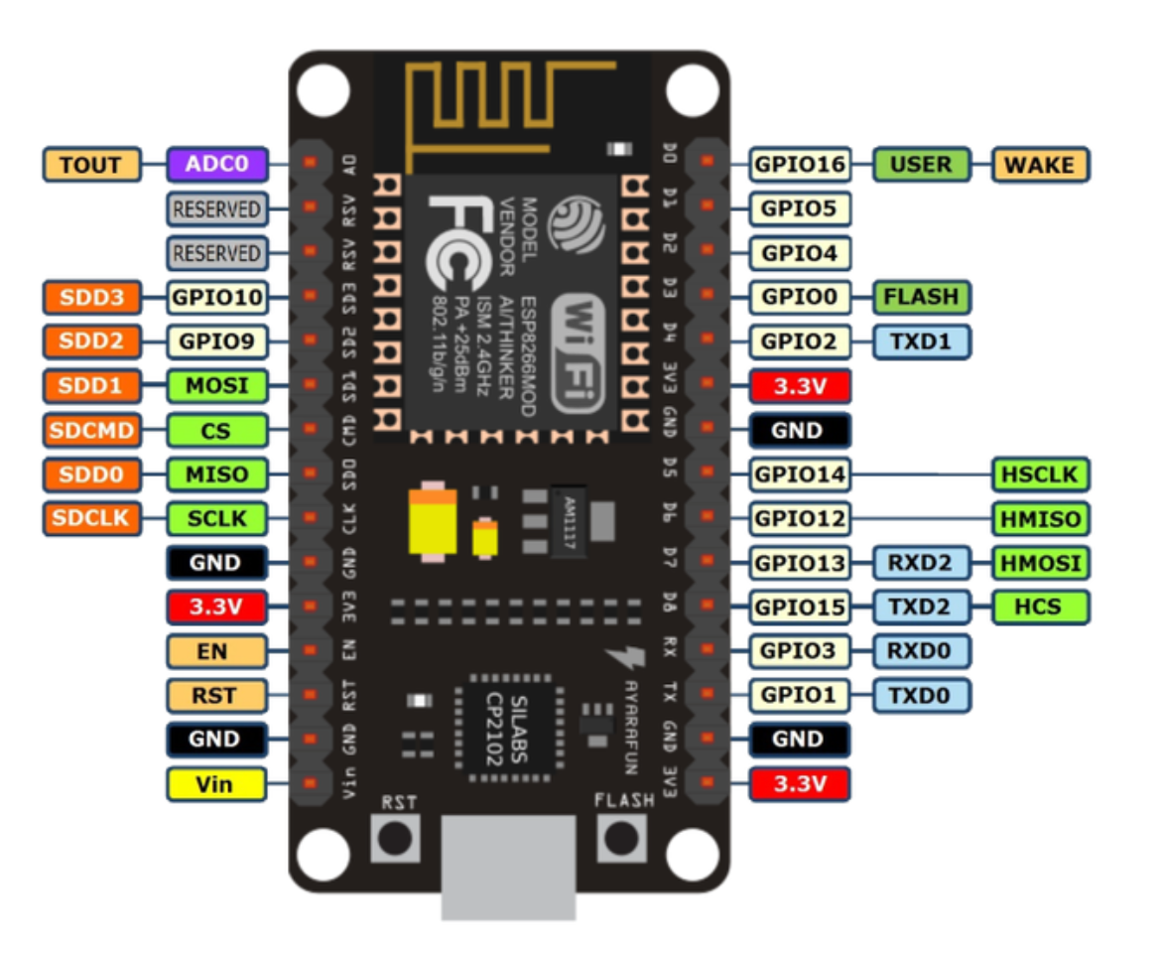
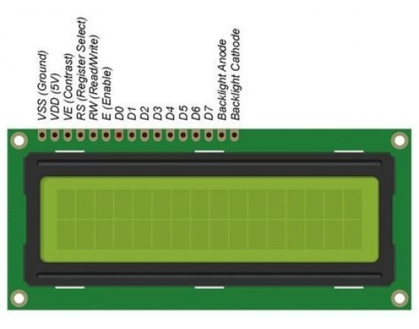
16X2 LCD Display
AWESOME
SLIDE
NodeMCU (ESP8266)

Slide 12
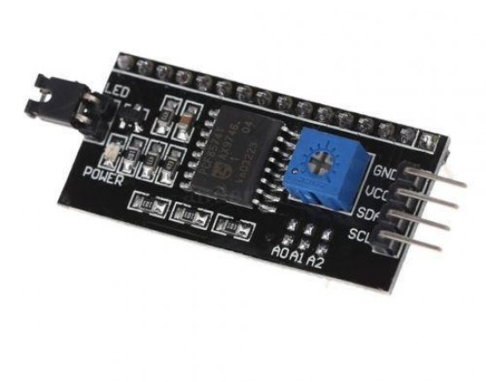
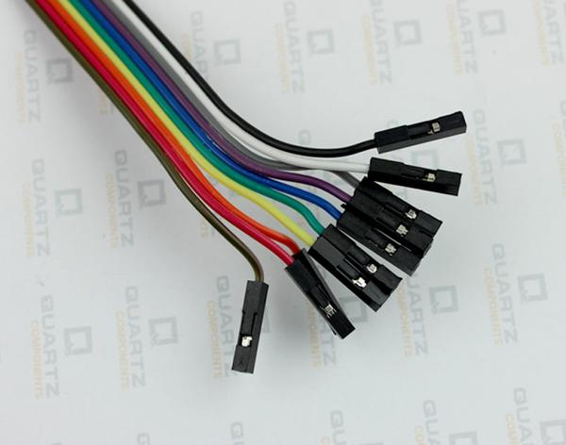
F2F Jumper Wires
AWESOME
SLIDE
I2C Interface Adapter

Slide 13
Software Details
01
02
03
04
Arduino Editor
ThingSpeak Cloud
MATLAB
Tinkercad
Arduino Integrated Development Environment is used to burn our embedded C code to our NodeMCU.
Tinkercad here will be used to demonstrate the software simulation of social distancing detector.
ThingSpeak cloud is used to parse in the data using XHTML Path of a website to our Wi-Fi module.
MATLAB is designed to render the code of our electronic mail alert system.

Slide 14


Software Details
Arduino Editor
ThingSpeak Cloud
ThingSpeak cloud will have dual usage. It will be first used as an API to fetch the data for displaying. Next, it will be used to create POST request to our E-mail alert system using Python script.
The online Arduino editor will have our embedded C code and we will burn the code into our NodeMCU (ESP8266) module.

Slide 15
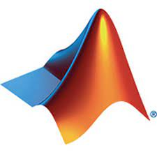

Software Details
MATLAB
Tinkercad
MATLAB will be used to code our alert system. It will use the conditional statements to determine if the number of cases have exceeds the given threshold.
Tinkercad will be used to demonstrate the software simulation of a social distance detector. This will be used when the number of cases exceed the given threshold.

Slide 16
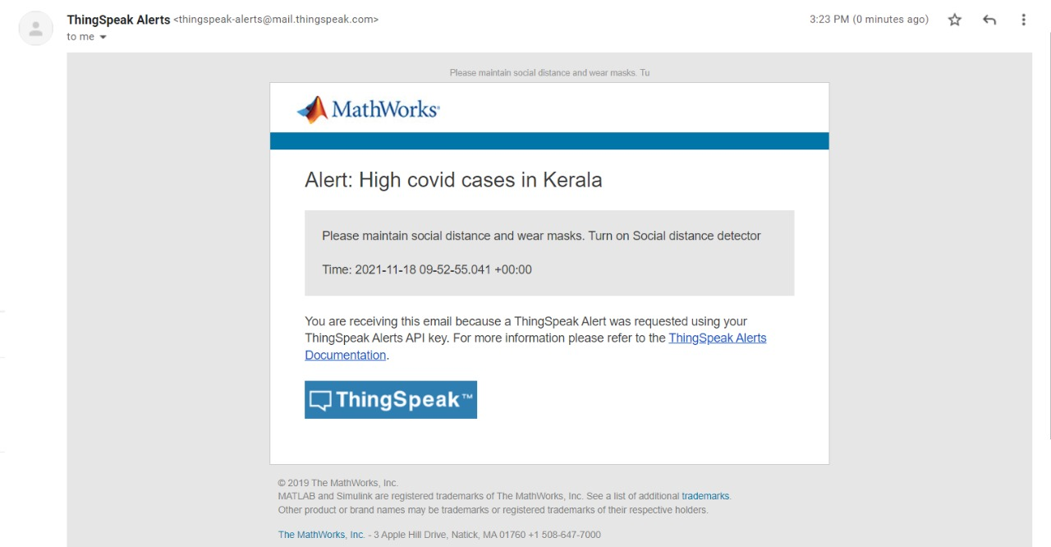
Work Completed
E-Mail Alert System
We have used MATLAB to implement the E-Mail alert system. It uses the POST method of ThingSpeak API to alert the user if the number of active cases in a particular state exceeds the initialized number.
This E-mail asks user to maintain social distancing and wear masks whenever they go outdoors. We also ask them to turn on the social distance detector.

Slide 17
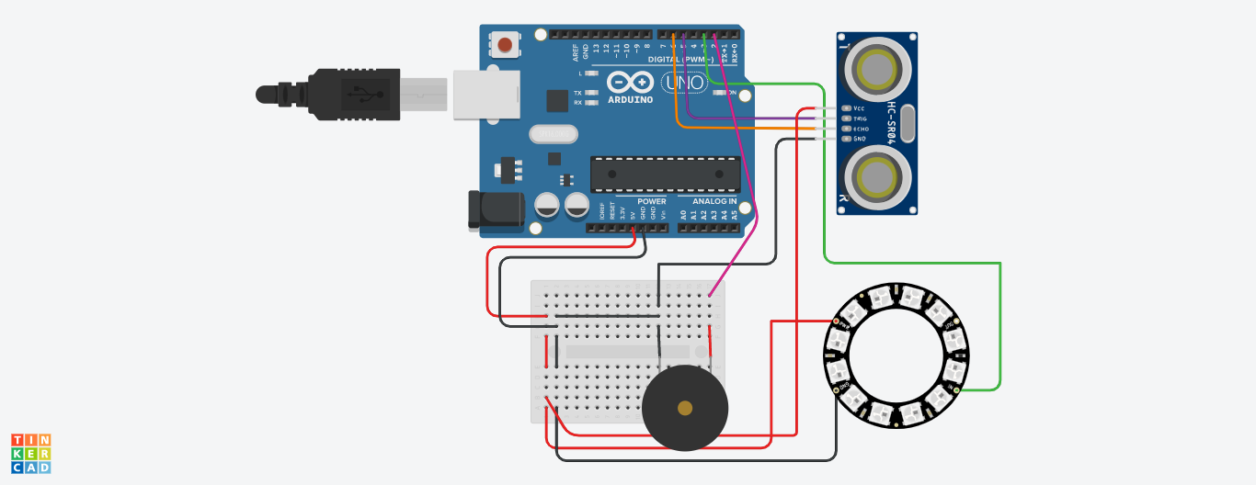
Work Completed Contd…
Social Distance Detector
We have used the software simulation of Tinkercad to demonstrate the working of a social distance detector.
The detector uses a ultrasonic distance sensor to find the range of another being.
It then deploys a buzzer if the distance detected is less than 6 feet and hence alerts the user of proximity to another person.

Slide 18
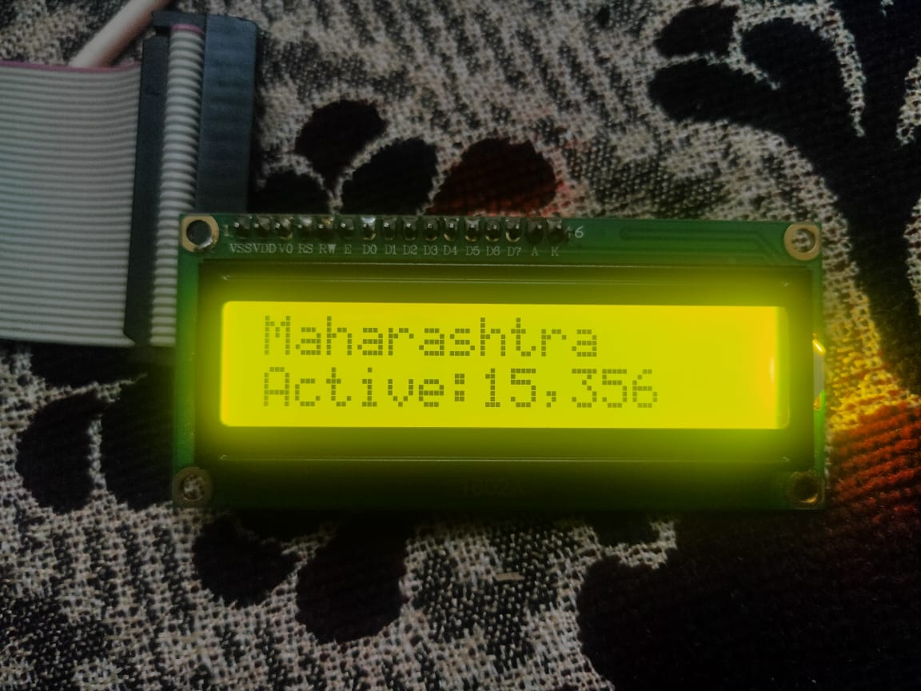
Work Completed Contd…
Hardware Configuration
We are also done with configuration of our hardware, connecting all the components together.
We have burned the Arduino code from online editor to our NodeMCU(ESP8266).
The LCD displays our different categories of cases and in different states.

Slide 19
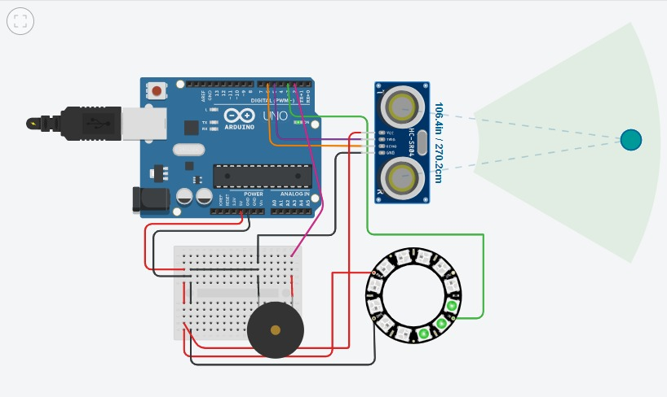
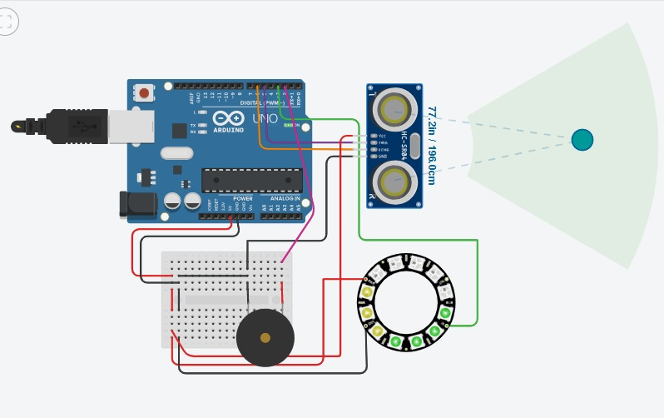
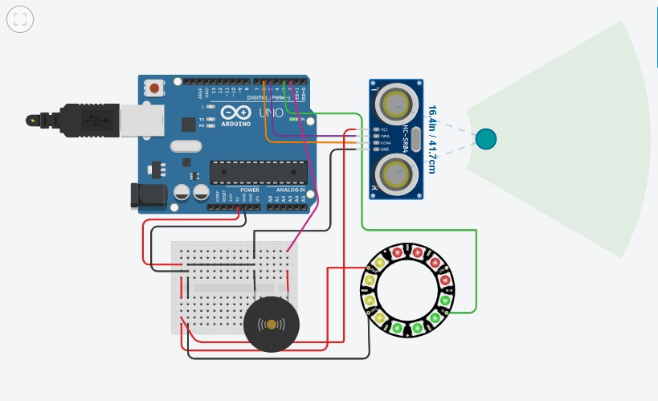
Results
Working of Social Distance Detector

Slide 20
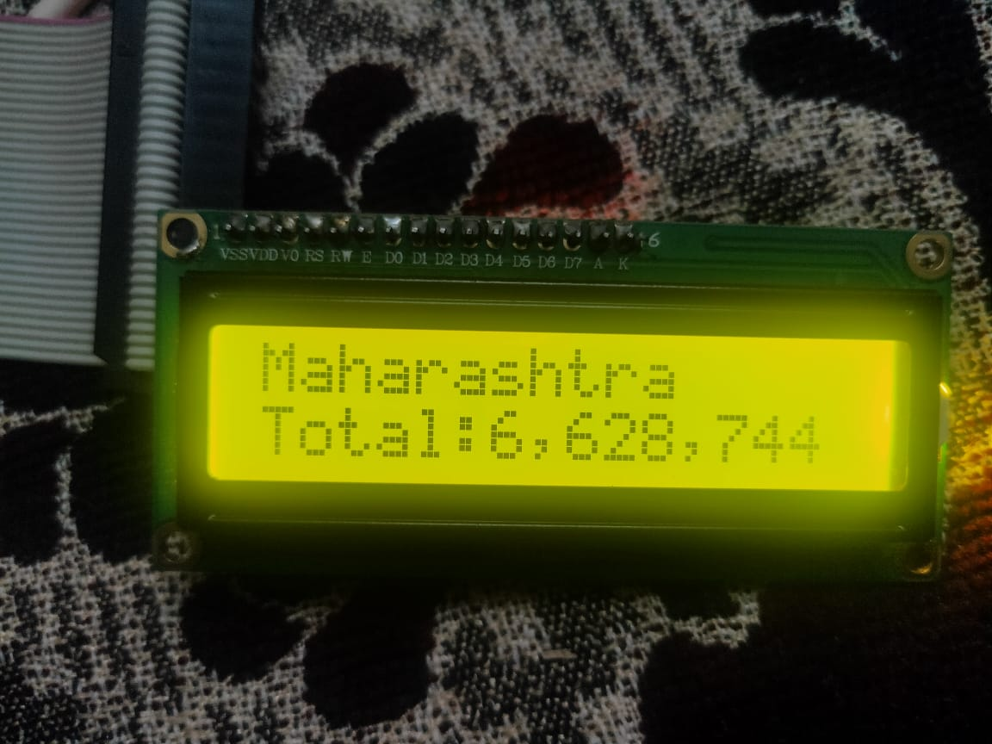
LCD Working
AWESOME
SLIDE
Total and Active Cases in Maharashtra

Slide 21
Results
Electronic Mail as Sent by our alert system

Slide 22
Thank You
Harshit Mishra
Pankaj Shivnani
Alokam Nikhitha
Galla Kiran

